Slide 1



POST MARKETING SURVEILLANCE OF HIV RAPID TESTS IN COTE D’IVOIRE
Dr CABLAN Arsher/Dr KOUAME Mireille
MOH/NPHL/ PMS program coordinator
RTCQI Best practise meeting, Cape Town August 26-30, 2024

Slide 2
OUTLINE
INTRODUCTION
OBJECTIVES
METHODOLOGY
RESULTS
WAY FORWARD

Slide 3
INTRODUCTION
Post Marketing Surveillance (PMS)
Monitors the safety, quality and efficacy of an IVD after it has been released on the market
Protects human and public health by reducing risks through continuous monitoring of IVDs placed on the market.
Ensures that the manufacturer complies with its obligations to assess the risks and/or mitigate the risks.
PMS activity started in Cote d’Ivoire in December 2019 conducted by the NPHL

Slide 4
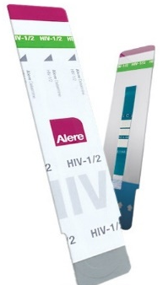
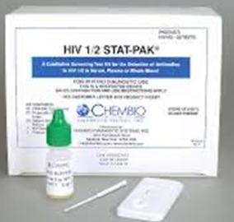
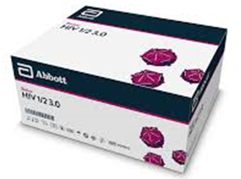
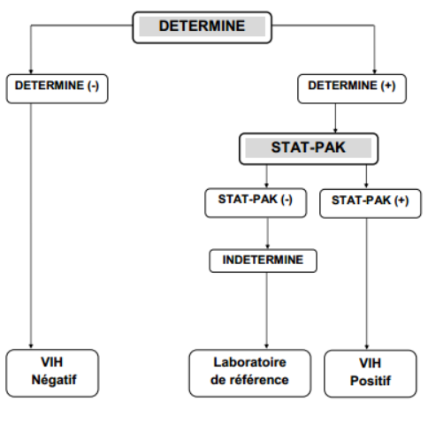
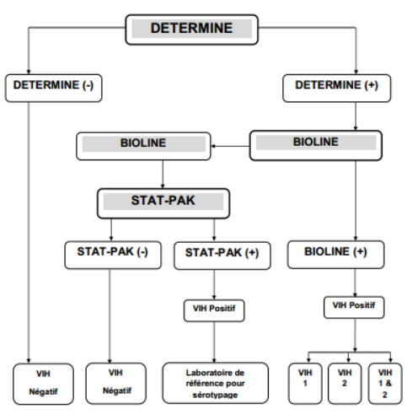
INTRODUCTION
HTS sites algorithm
Confirmatory Laboratory algorithm

Slide 5
OBJECTIVES
General : To verify the performance of HIV rapid tests before distribution and after distribution at the site of use.
Specific :
1- Evaluate any new batch coming in country
2- Carry out an inter-comparison of batches of HIV rapid tests from the national medical store
3- Evaluate the performance of HIV tests kits in districts and health facilities

Slide 6
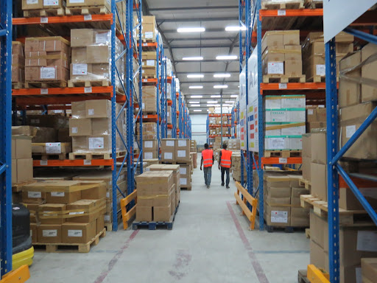
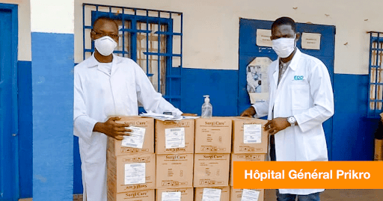
METHODOLOGY
RANDOM SAMPLING
At the central medical store: NPSP
Districts
Health centers (CHU, CHR, HG, ESPC)
- 25 per/year
- 100 tests/lot (Max 200 tests/ Site)
- Storage condition monitored (T°, Humidity rate): on site,
during transport after sampling, during storage until
evaluation at the NPHL
2019
2020, 2023
Central d’achat

Slide 7
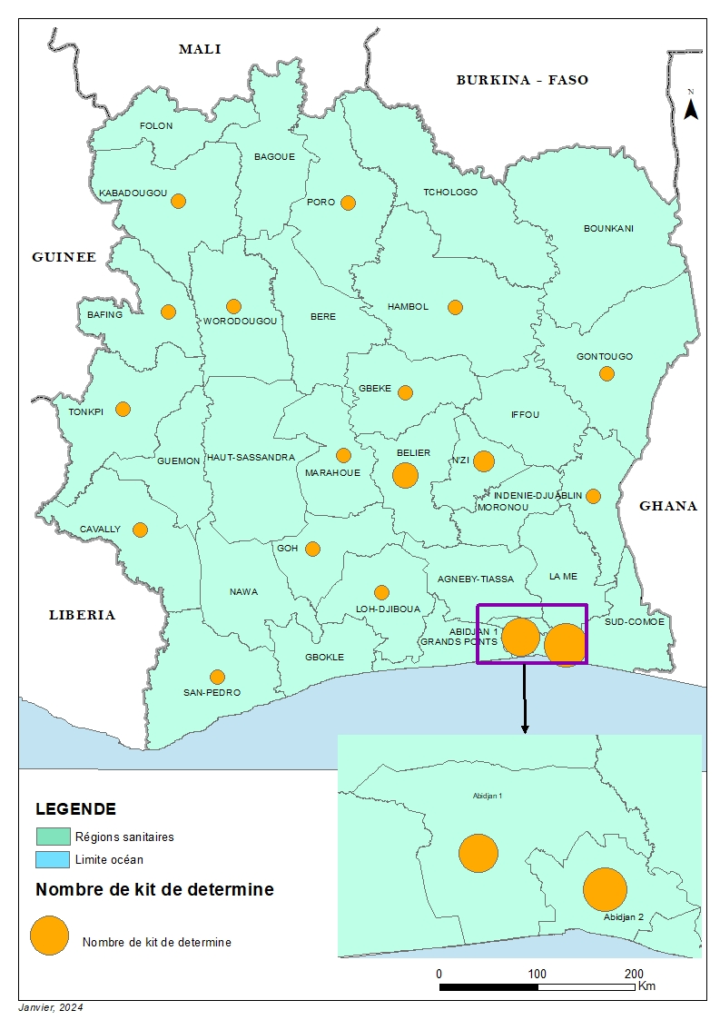
N° | Etablissement sanitaire | Determine | Bioline | Stat-Pak
1 | EPHR Abobo Nord | 1 | 0 | 0
2 | EPHR d’Abengourou | 1 | 0 | 0
3 | EPHR d’Odienné | 1 | 0 | 1
4 | EPHR de Bondoukou | 1 | 1 | 1
5 | EPHR de Bouaflé | 1 | 1 | 1
6 | EPHR de Daloa | 0 | 1 | 1
7 | EPHR de Dimbokro | 1 | 0 | 0
8 | EPHR de Divo | 1 | 1 | 1
9 | EPHR de Gagnoa | 1 | 1 | 1
10 | EPHR de Guiglo | 1 | 0 | 0
11 | EPHR de Katiola | 1 | 1 | 1
12 | EPHR de Korhogo | 1 | 1 | 1
13 | EPHR de Man | 1 | 1 | 1
14 | EPHR de San Pedro | 1 | 1 | 1
15 | EPHR de Séguela | 1 | 1 | 1
16 | EPHR de Touba | 1 | 1 | 1
17 | EPHR de Yamoussoukro | 1 | 1 | 1
18 | CHU de Bouake | 1 | 1 | 1
19 | CHU de Cocody | 1 | 1 | 1
20 | CHU de Treichville | 1 | 1 | 1
21 | CHU de Yopougon | 0 | 1 | 1
22 | DDSHP d’Abobo-Ouest | 1 | 0 | 1
23 | DDSHP de Dimbokro | 1 | 0 | 1
24 | DDSHP de Koumassi-Port-Bouët-Vridi | 1 | 2 | 1
25 | DDSHP de Treichville-Marcory | 1 | 1 | 1
26 | DDSHP de Yamoussoukro | 2 | 1 | 2
27 | ESPC Abidjan | 8 | 0 | 0
28 | Nouvelle PSP | 4 | 2 | 1
 | Total 16 EPHR, 4 DDSHP, 4 CHU, 8 ESPC | 37 | 22 | 24
COLLECTION SITE LOCATION

Slide 8
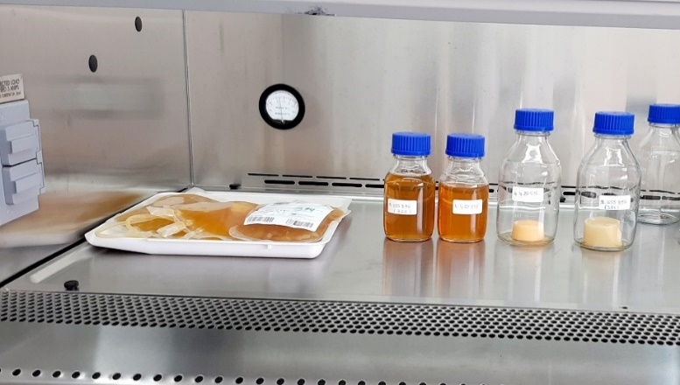
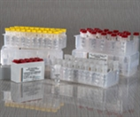
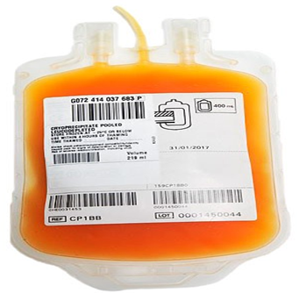
METHODOLOGY
EVALUATION
Use of panels characterized by 2 ELISA techniques in parallel +/- LIA
(In house Panels, Commercial Panels)
Reference lot compared to subsidiary lots: Inter-lot comparison:
In house panel from NBTS
Commercial panel
Characterisation algorithm
Panel maison à partir de poche de sang

Slide 9
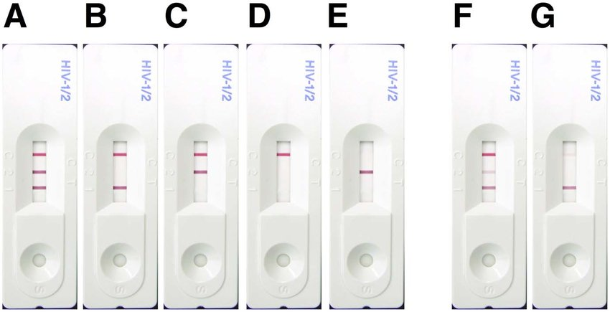
METHODOLOGY
Performing rapid tests
Testing according to the manufacturer's recommendations
Reading of the results by two independent technicians
If discrepant results, then third reading by a supervisor, the final result is the one that is read twice out of the three.

Slide 10
RESULTS

Slide 11
INTERCOMPARISON OF BATCHES AT THE CENTRAL MEDICAL STORE
Chembio HIV 1/2 STAT-PAK could not be evaluated in a lot-to-lot comparison
because only one batch was available at the central warehouse.
However, this lot was used as a reference lot

Slide 12
LOT COMPARISON : DETERMINE
Determine reference batche : 00925K200R
90%
90%
Limite d’acceptabilité
The batches of Determine taken from the central warehouse comply with the acceptability criteria
defined in comparison to the reference lot

Slide 13
LOT COMPARISON : BIOLINE
Determine reference batche 03ADD009A
80%
90%
Limite d’acceptabilité
The batche of Bioline taken from the central warehouse comply with the acceptability criteria
defined in comparison to the reference lot

Slide 14
POST-DISTRIBUTION RESULTS
With the low number of kits collected from the peripheral sites,
The comparison of batches used only dilution panel

Slide 15
RESULTS
Number of tests kits collected in health centers
PMS Sessions
Each year, 25 health centers are selected. At least 100 samples of each type of test
are expected (1 Determine kit, 4 Bioline kits, 5 Stat-Pak kits). On the 2020 and 2023 sessions, many
tests shortages have been observed in many health centers.

Slide 16
RESULTS
Tests kits | Results (%) | Acceptance | Interpretation
Determine | 93.7-100 | ≥90% | Conforme
Bioline | 100
Stat-pak | 100
The tests collected and evaluated in post-distribution showed satisfactory performance according to the criteria defined using dilution panels

Slide 17
RESULTS
Quality HIV kits batches assessed is acceptable both at the central medical stores and at the sites
No significant variation appeared between the batches evaluated.
Storage temperatures and humidity rate are within manufacturers' recommended ranges
Numerous tests kits stock-outs at the sites level

Slide 18
WAY FORWARD
Development of a new database for the new HIV/Syphilis screening algorithms in Côte d'Ivoire
Characterization of an in-house panel in replacement of the commercial one expiring soon
Routine monitoring of any new test batch entering in the central medical store
Decentralization of some activities (PT, Certification, PMS, Misdiagnosis)
Develop the framework for PMS activity implementation including the report dissemination for decision making

Slide 19

















ACKNOWLEDGMENT

